Slide 1
CECU’s Annual Report to California!
Steve Gunderson, President and CEO
October 11, 2019

Slide 3
“As the World Turns…”
“Here’s Our World Today!”

Slide 4
Legislation in the 116th Congress Against the Sector
Now 15 pieces of legislation with Lee’s Resolution of Disapproval of BDR.
4

Slide 5
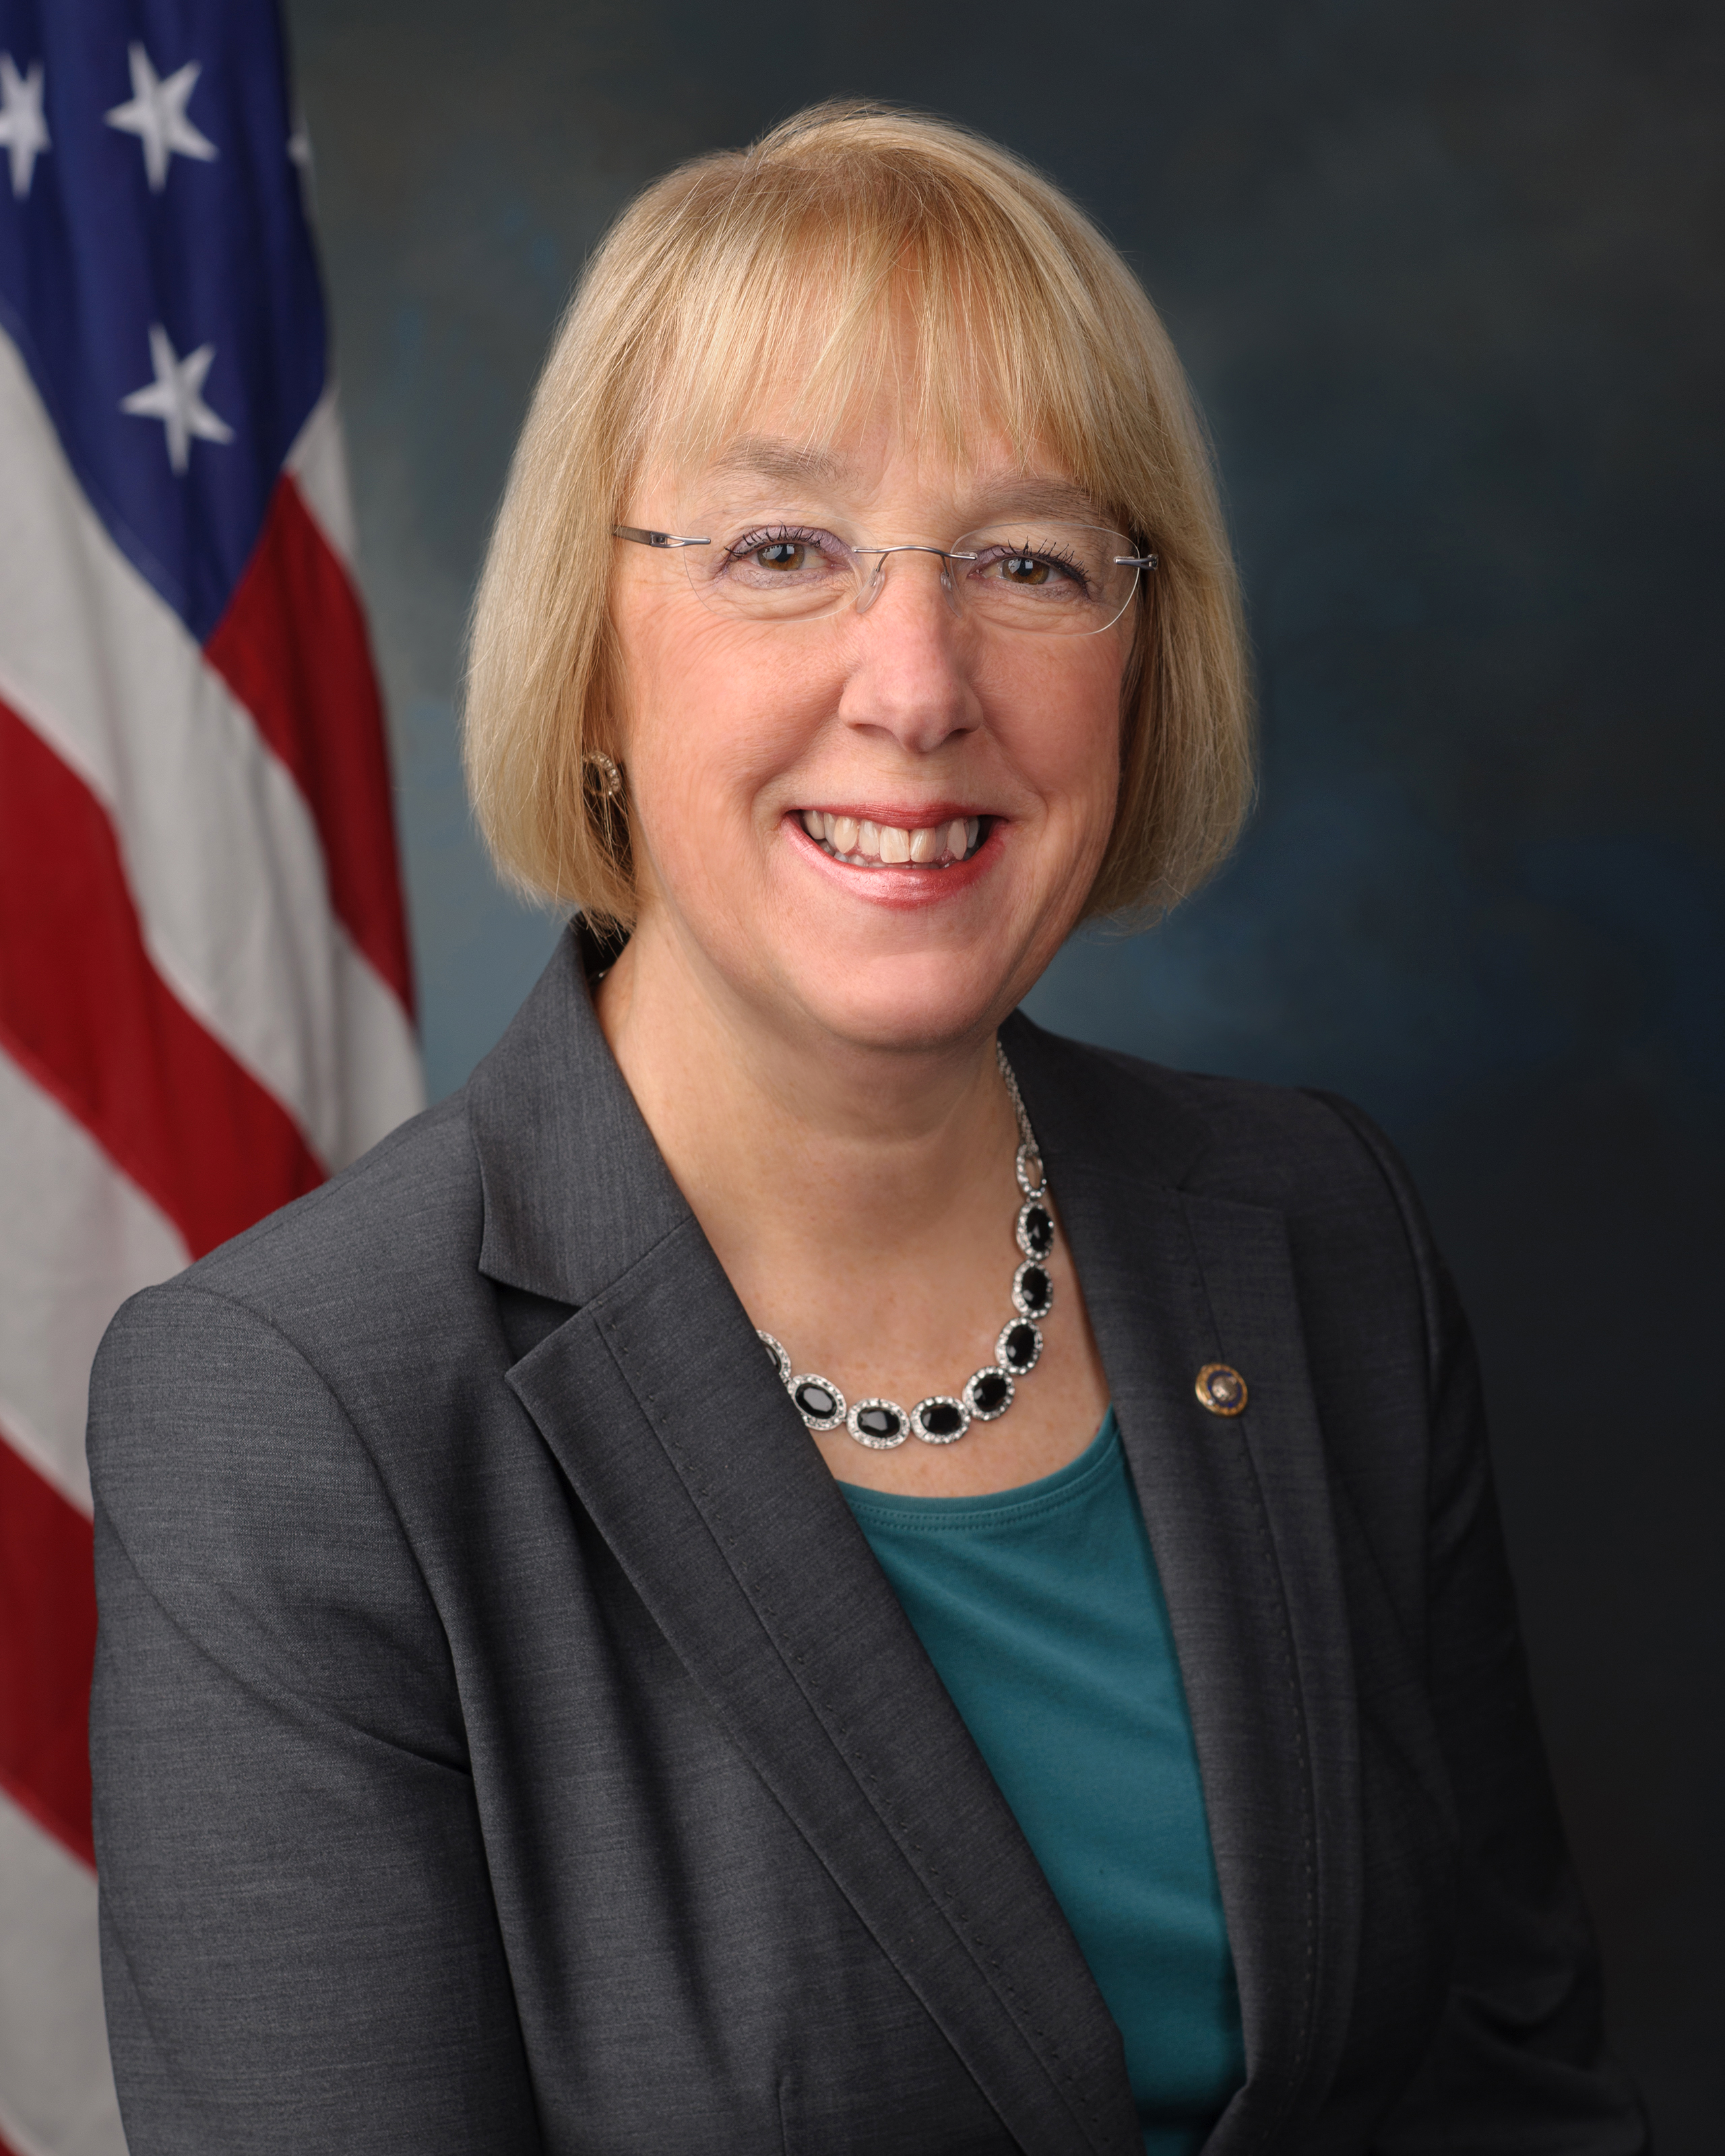
The Senate’s ranking Democrat Message to all D’s
Senator Patty Murray

Slide 6
The Agenda Changes!
Key Message #1
6

Slide 7
We began the year pushing for Bi-Partisan HEA Reauthorization.
Opponents use veterans as a wedge!

Slide 8
Career Education Colleges and Universities - 2019 GR Priorities -
Access to Postsecondary career Ed
Protect Veterans Access
HEA Re-Authorization:
Short-Term Pell
Risk-Adjusted Repayment Rates
BDR w Due Process
Restore TRIAD
Revise Audits
Prioritize Students in School Closures
Restore ATB
November 16, 2018

Slide 9
The Proposals begin:
90/10: Closing “The Loophole!”
85/15
80/20

Slide 10
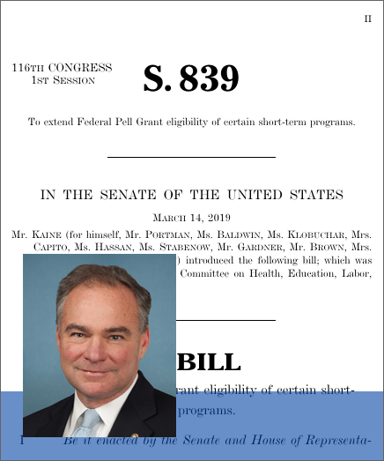
SB 839: The Kaine-Portman JOBS Act of 2019 introduced March 14, 2019

Slide 11
These are Examples of 2 Strategies by our Opponents:

Slide 12
Their Campaign to Remove Veterans’ Access to Career Schools
Key Message #2
12

Slide 13
Their Campaign to Remove the Sector from Federal Funding!
Key Message #3
13

Slide 14
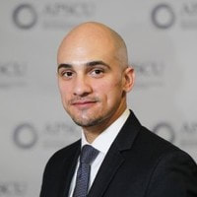
They believe:
“They believe: If we can cut off Veterans, we can cut off everything else!”
Michael Dakduk
Executive VP & Director of
Government Relations
14

Slide 15
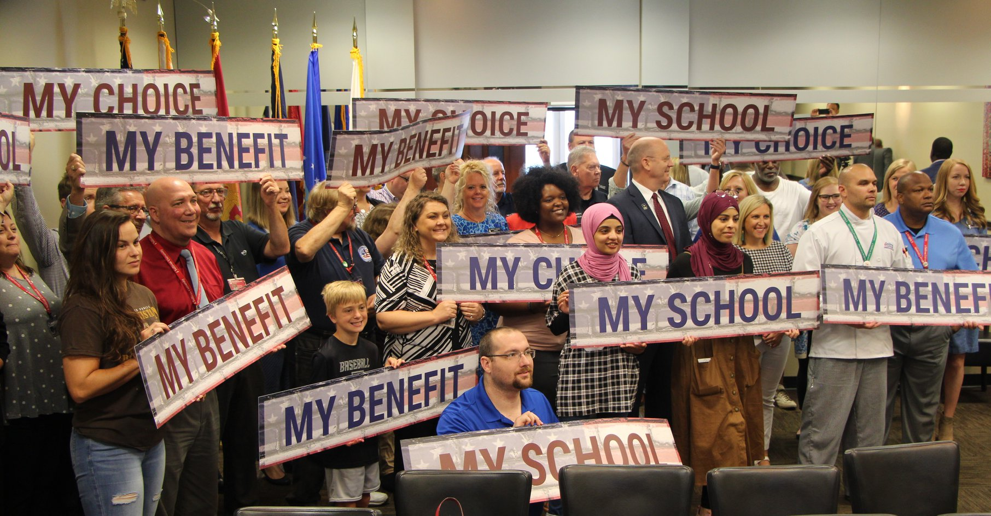
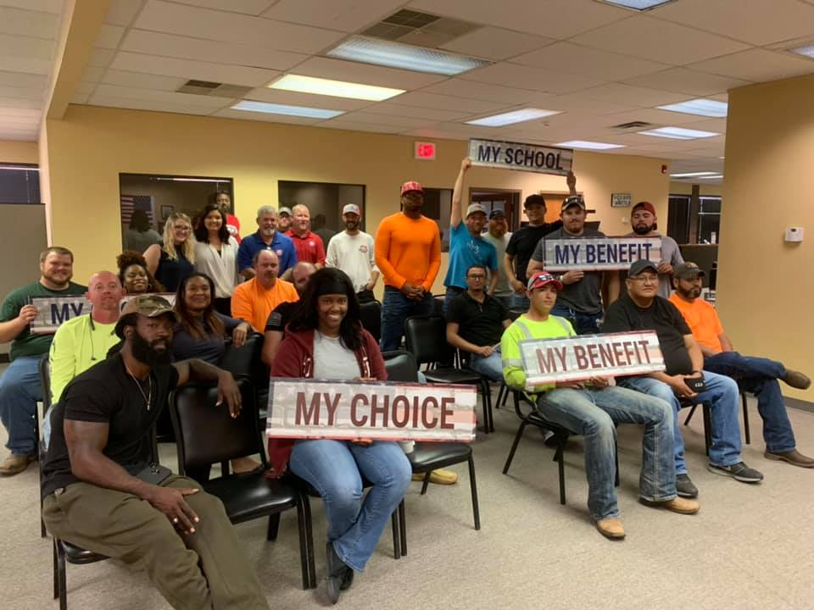
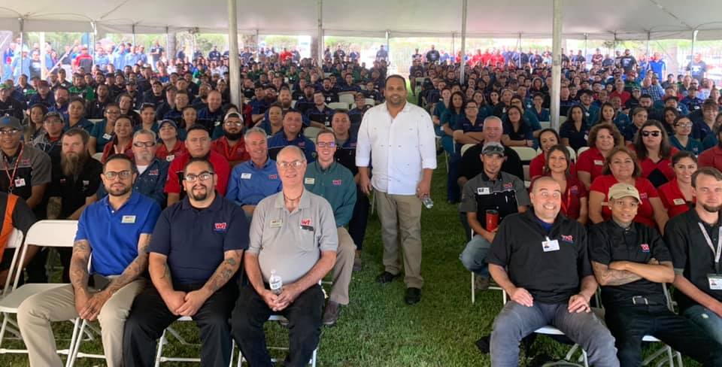
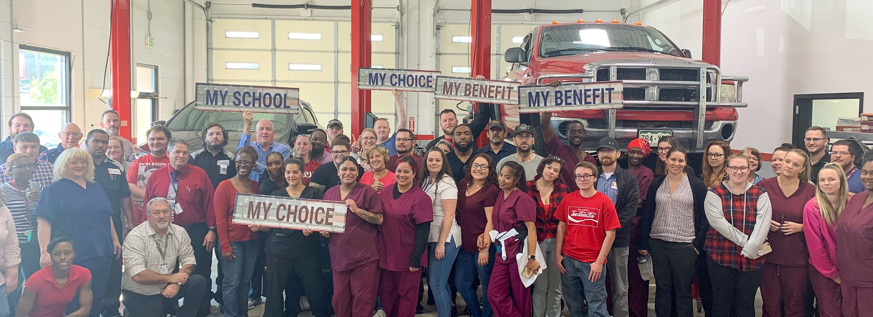
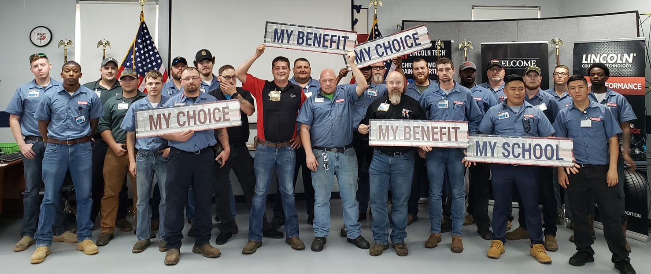
The Campaign to Protect Veterans’ Access

Slide 16
The Budget:
The Budget: $619,000 Raised in new donations!
16

Slide 17
The Post-9/11 GI Bill Benefit
17

Slide 18
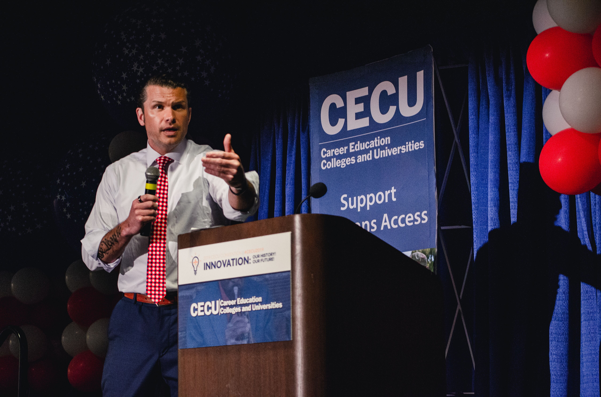
The Voice
18

Slide 19
Veterans for Career Education
19

Slide 20
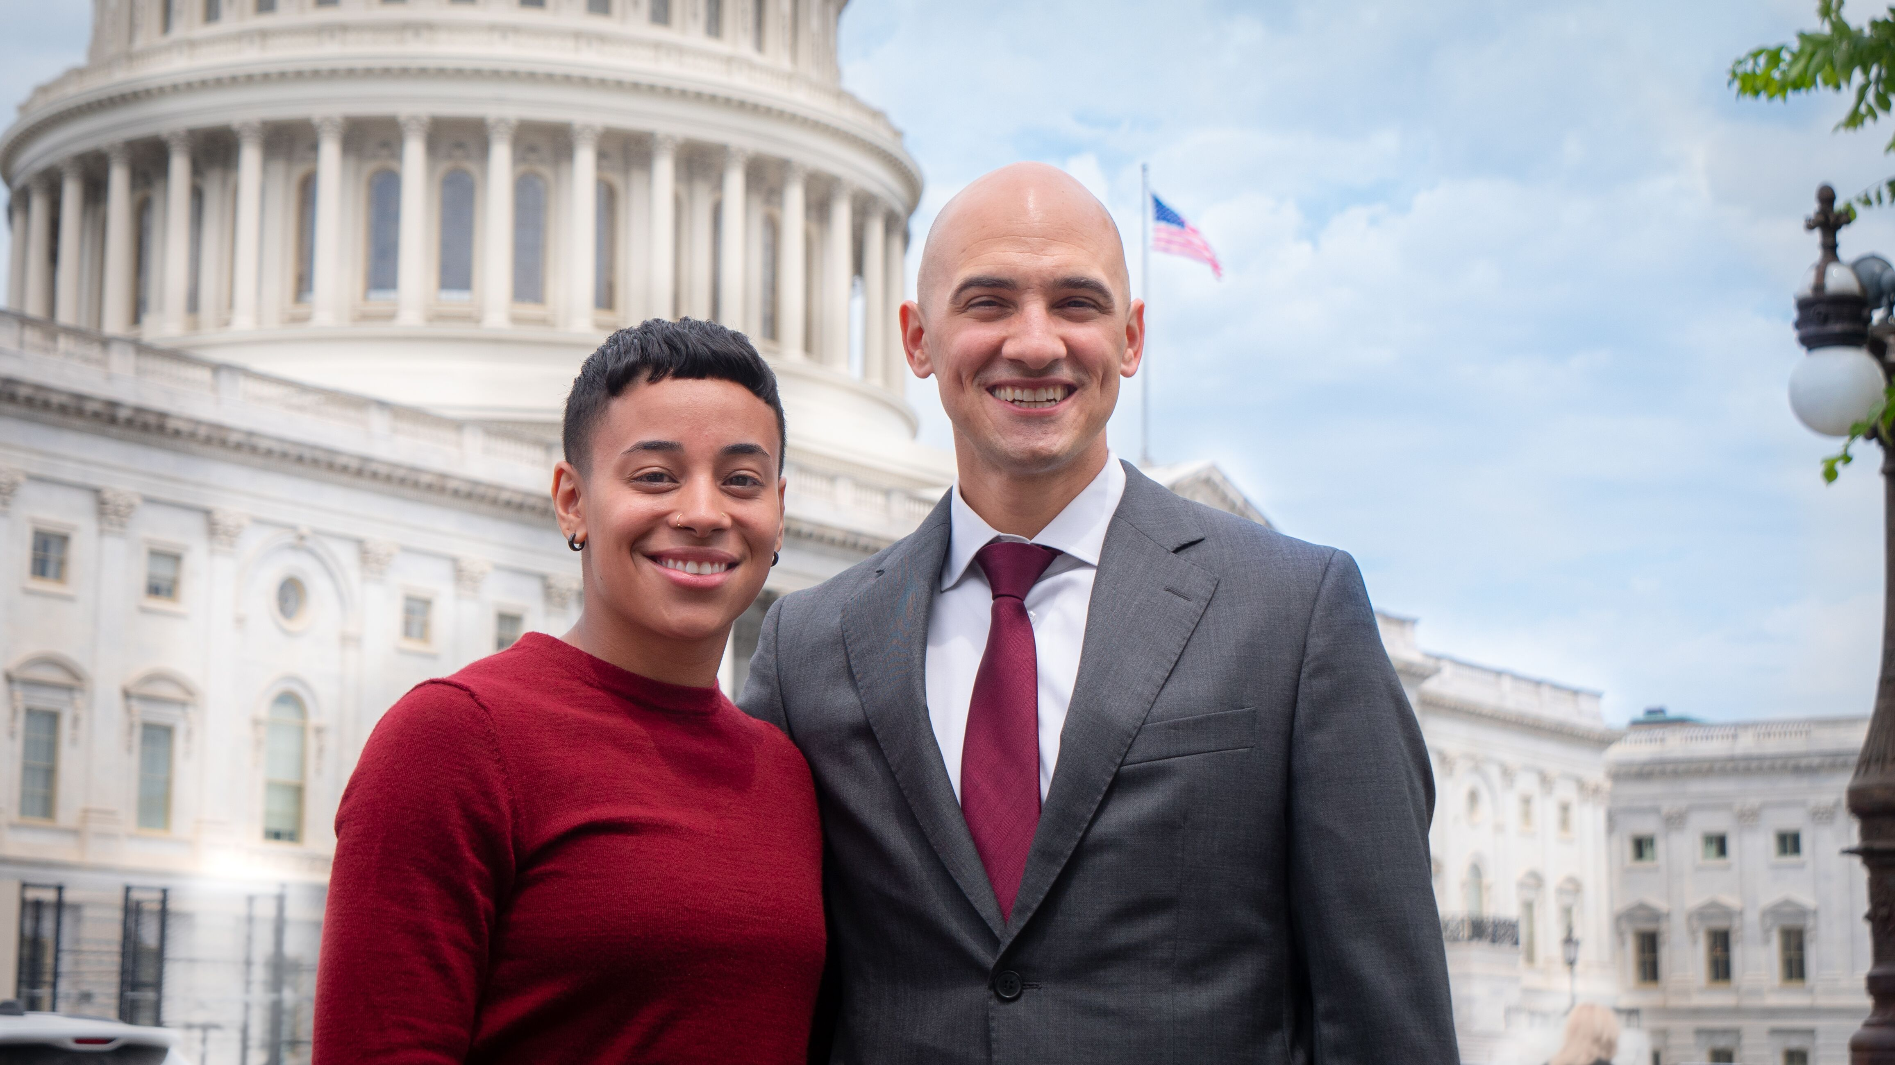
Veterans for Career Education Co-Chairs
Kristyl Rodriguez & Michael Dakduk
20

Slide 21
Veterans for Career Education
21

Slide 22
Veterans for Career Education
33 school rallies to date!
1,585 VCE Members!
22

Slide 23
Veterans for Career Education
Our Goal: 2,500 VCE Members by the end of 2020!
23

Slide 24
We are changing the Face and the Mission of our Sector!
Key Message #4
24

Slide 25
Changing the Face of our Sector
From Corinthian/ITT to Veterans
25

Slide 26
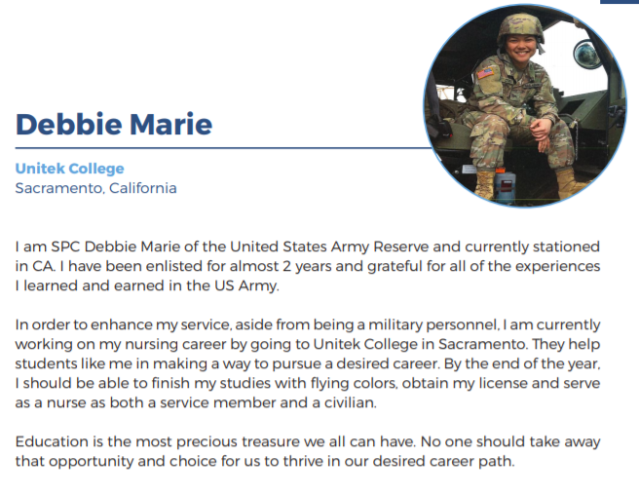
Changing the Mission of our Sector
From “For-Profit Schools to Postsecondary Career Education!
26

Slide 27
When Rhetoric becomes Reality!
Change 90/10
Eliminate use of GI Benefits in sector
Short Term Pell
No participation by Proprietary Sector
The 2020 Presidential Campaign
27

Slide 28
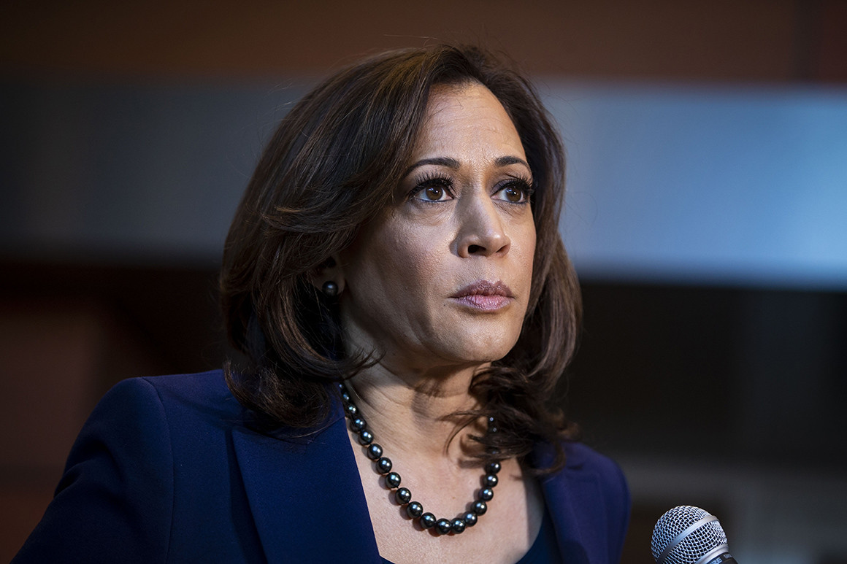
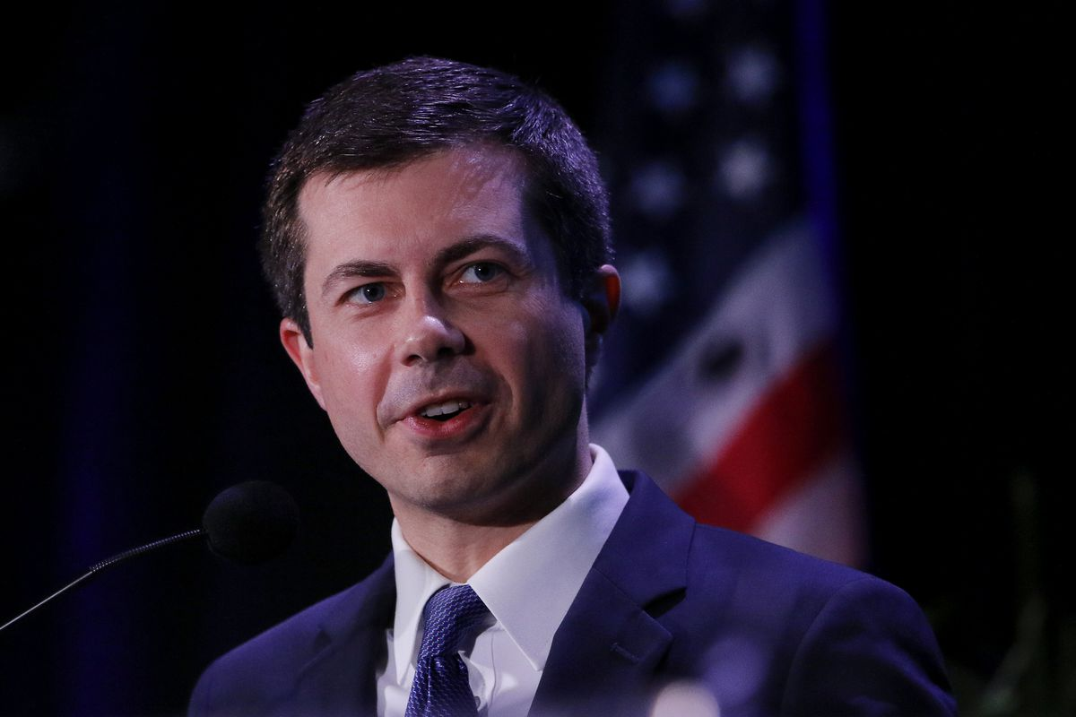
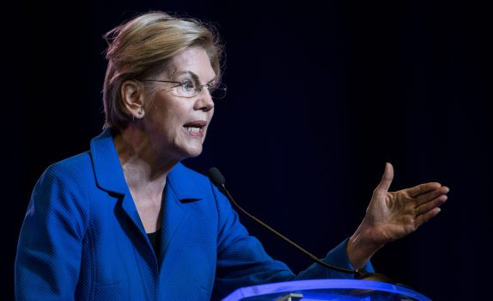
“We need to get rid of the for-profit colleges...”
Senator Kamala Harris
CNN Town Hall
January 29, 2019
"The moment I deployed, my Facebook feed started filling up with ads from these for-profit colleges. On my watch, those colleges that turned the Department of Education into a predatory lender -- that’s where we'd start getting rid of loans.”
Pete Buttigieg
Democratic Primary Debate
July 30, 2019
“Ban for-profit colleges from receiving any federal dollars.”
Senator Elizabeth Warren
Higher Education Plan
Unveiled in 2019
28

Slide 29
The Agenda Changes - Again!
Key Message #5
29

Slide 30
The Alexander Proposal:
8 proposals, including:
FAFSA Simplification
Pell Grants for Prisoners
Short-Term Pell
Increase Maximum Pell Grant Award
Permanent Funding for HBCs
30

Slide 31
The Message:
“Everyone is Eligible for the Short-Term Pell”
“Everyone must meet the criteria!”
31

Slide 32
Our Challenge:
We need to get the votes to keep this compromise language in the bill!
32

Slide 33
AIM Higher Act:
Restore Obama BDR in statute
Restore Obama GE in statute
85/15, closing “loophole!”
Short-Term Pell, Our sector excluded
Limits on Marketing Dollars
Minimums on Academic Instruction
33

Slide 34
Preparing for Whatever 2020 Brings!
Key Message #6
34

Slide 35
We Must Prepare For:
A Trump 2nd Term (with new personnel likely)
A Democrat President – and maybe a Democrat Congress.
35

Slide 36
June 2019 through December 2020
18 Months to:
Do as much as we can in GR now!
Grow Grassroots!
Build our PAC!
2,500 VCE Members!
Become the Voice of Postsecondary Career Education!
36

Slide 37
We will be guided by 3 Values:
Outcome Metrics for all programs, all schools
Full Transparency of Outcomes
Separate on-site from exclusive on-line liberal arts schools.
37

Slide 38
The Demand for our students and our schools continues to Grow!
Key Message #7
38

Slide 39
In the end We will succeed because we are responding the demand for skilled workers!
39

Slide 40
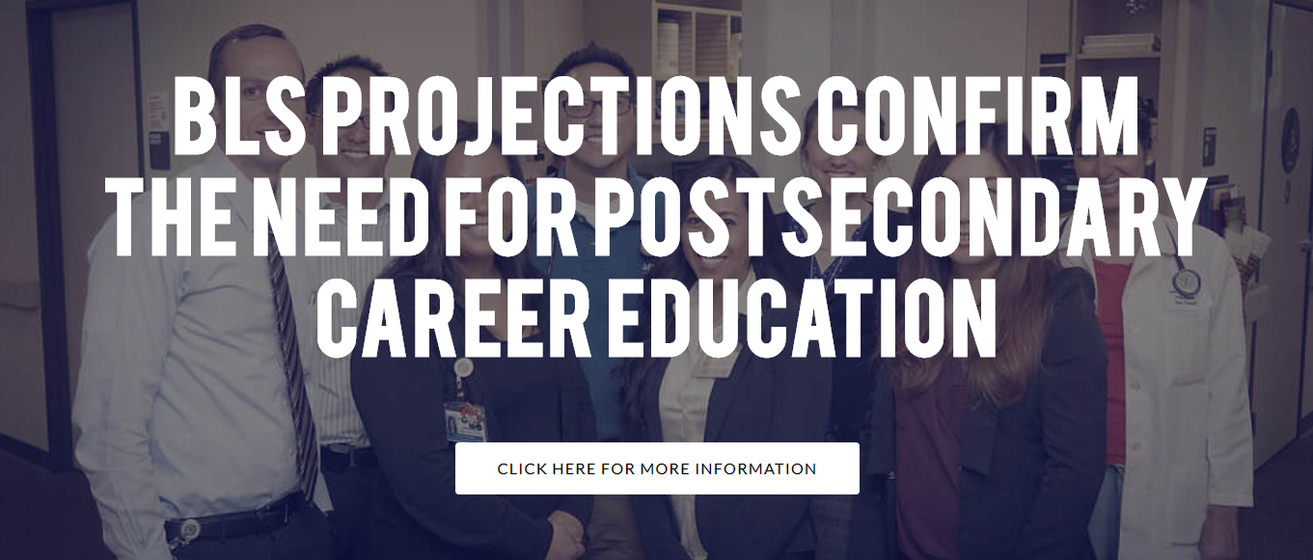
The September BLS Projections: 2018-2028
40

Slide 41
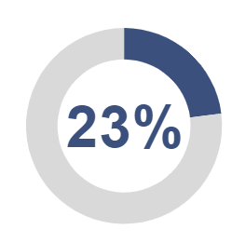
Medical Assistants
Growth
99,700
average annual demand!
154,900
new jobs
842,000
jobs due to separations
41

Slide 42
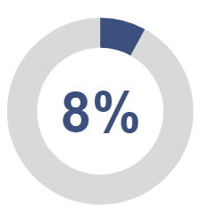
Cosmetology, Hair Stylist, Barbers:
Growth
104,700
average annual demand!
63,900
new jobs
983,000
jobs due to separations
42

Slide 43
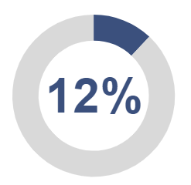
Registered Nurses
Growth
210,400
average annual demand!
371,500
new jobs
1.733 million
jobs due to separations
43

Slide 44
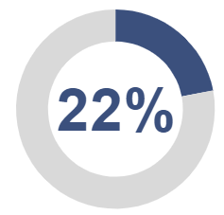
Massage Therapists
Growth
24,200
average annual demand!
35,400
new jobs
207,000
jobs due to separation
44

Slide 45
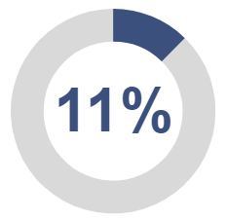
Dental Assistants
Growth
44,800
average annual demand!
38,700
new jobs
409,000
jobs due to separations
45

Slide 46
Licensed Practical Nurses (LPN)
Growth
66,300
average annual demand!
78,100
new jobs
585,000
jobs due to separation
46

Slide 47
Culinary Chef
Growth
20,700
average annual demand!
15,400
new jobs
192,000
jobs due to separations
47

Slide 48
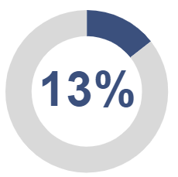
HVAC Technician
Growth
42,800
average annual demand!
46,300
new jobs
382,000
jobs due to separations
48

Slide 49
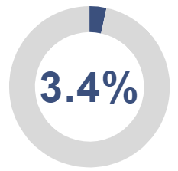
Welders, cutters, solderers, etc.
Growth
48,800
average annual demand!
14,500
new jobs
473,000
jobs due to separations
49

Slide 50
In Summary
The Demand for Skilled Workers is our greatest guarantee for the future!
8.4 million new jobs by 2028
Most of our programs are in growth occupations!
Remember: 18,854,200 separations projected annually!
Annual Demand for new skilled workers: 19,694,000!
50

Slide 51
In closing… The world won’t turn…
…without our graduates!
51

