Slide 1



DFPI Annual Report Training
A comprehensive guide for career school administrators on completing the 2026 California Department of Financial Protection and Innovation annual report for education lenders.
Benji Breitbart, TFC Tuition
(800) 832-5626
compliance@TFCtuition.com

Slide 2





TRAINING AGENDA
What We Will Cover
What is this Report?
How to Gain Access
How to Complete It
Servicer Support
Leveraging your servicer for assistance
Understanding the regulatory requirements and purpose
Registering and logging into the DFPI portal
Step-by-step guidance through each section

Slide 3

What is the Annual Report?
Regulatory Mandate
Required by the California Department of Financial Protection and Innovation (DFPI) as part of the registration regulation for education lenders.
Legal Framework
Governed by California Code of Regulations, title 10, sections 1041-1045
Due Date
March 16, 2026 (extended from March 15 due to Sunday)
School Authorization
Must be completed and signed by an authorized officer of your institution

Slide 4




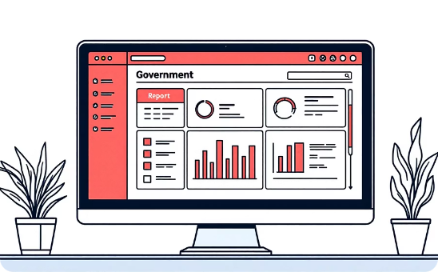
To Access the Report:
1. Log in to DFPI Portal
2. Register
3. Answer Key Question
Access the DFPI Self Service Portal with your credentials. No account yet? Continue to step 2.
Click the registration link and complete all required fields accurately.
When asked "Are you currently registered as a Covered Person with the CA DFPI?", select "Yes" and click "Submit Registration."
4. Await Approval
5. Find the Report
DFPI's NCP program staff will review your request within 5 business days. Look for a "Sign Up Confirmation" message.
Once approved, navigate to "Annual, Liability, & Industry Survey Reporting" in your portal dashboard.

Slide 5

SECTION 1
Filling Out the Report: Section 1, Identifying Information
Section 1 captures your institution's core identifying and contact details. Ensure all information matches your official DFPI and NMLS records.
Registrant's or Licensee's Identifying and Contact Information
DBA/Fictitious Business Name
Mailing Address
NMLS ID (Found in NMLS)
Registration/License # (Found in NMLS)
Designated E-mail filed with DFPI
Business Phone Number
Website Address
Name of Designated Contact Person

Slide 6
SECTION 2
Filling Out the Report: Financing Data
1
2
3
4
Organization Type
Education Financing Activity
Gross Income
Contract Volume
Q2: Report total gross income from education financing to California residents during the prior calendar year
Q3: Enter total number of education financing contracts entered into with California residents during the prior calendar year
Select your legal structure: Corporation, LLC, General Partnership, Limited Partnership, Sole Proprietor, or Other
Q1: Indicate whether you provided education financing to California residents (Yes or No)

Slide 7
SECTIONS 4 & 5
Income-Driven Repayment Provisions
Important Note
Contact Your ISA Provider
Aggregate All Locations
Coordinate Data Collection
These sections require specialized data about contracts with income-driven repayment provisions, including income-share agreements.
Reach out to your income-share agreement provider for specific information needed to complete these sections accurately.
This report covers all locations and providers under your registration. If you work with multiple service providers, you'll need to combine their data.
Begin gathering information early to ensure you have time to consolidate data from all relevant sources before the deadline.

Slide 8
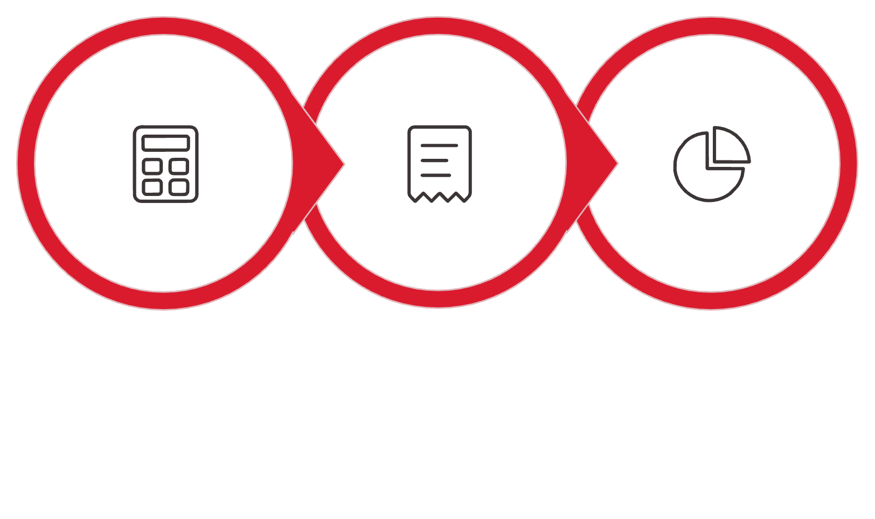



SECTION 6
Contracts Without Income-Driven Repayment
Calculate Advances
Determine Payoff
APR Distribution
Section 6 focuses on traditional education financing contracts that do not include income-driven repayment provisions.
Total Amounts Advanced
Payoff Amounts
APR Distribution
Report the aggregate dollar amount advanced to borrowers under these contracts during the reporting period
Calculate the total dollar amount required to pay off all such contracts at origination. This may be the same as Total Amounts Advanced
Complete the frequency distribution table showing the range and distribution of Annual Percentage Rates across your contracts

Slide 9

How Your Servicer Can Help
Comprehensive Reporting
Your loan servicers can provide detailed reports that answer all required questions for the loans they manage, including transaction volumes, outstanding balances, and repayment data.
Multi-Servicer Coordination
Remember: this report must include all loans under your registration, regardless of which servicer manages them. You'll need to aggregate data across all servicers and internal reports.
DFPI Communication Partnership
Work collaboratively with your servicers when communicating with DFPI to ensure consistency in reporting and maintain regulatory compliance across all relationships.

Slide 10
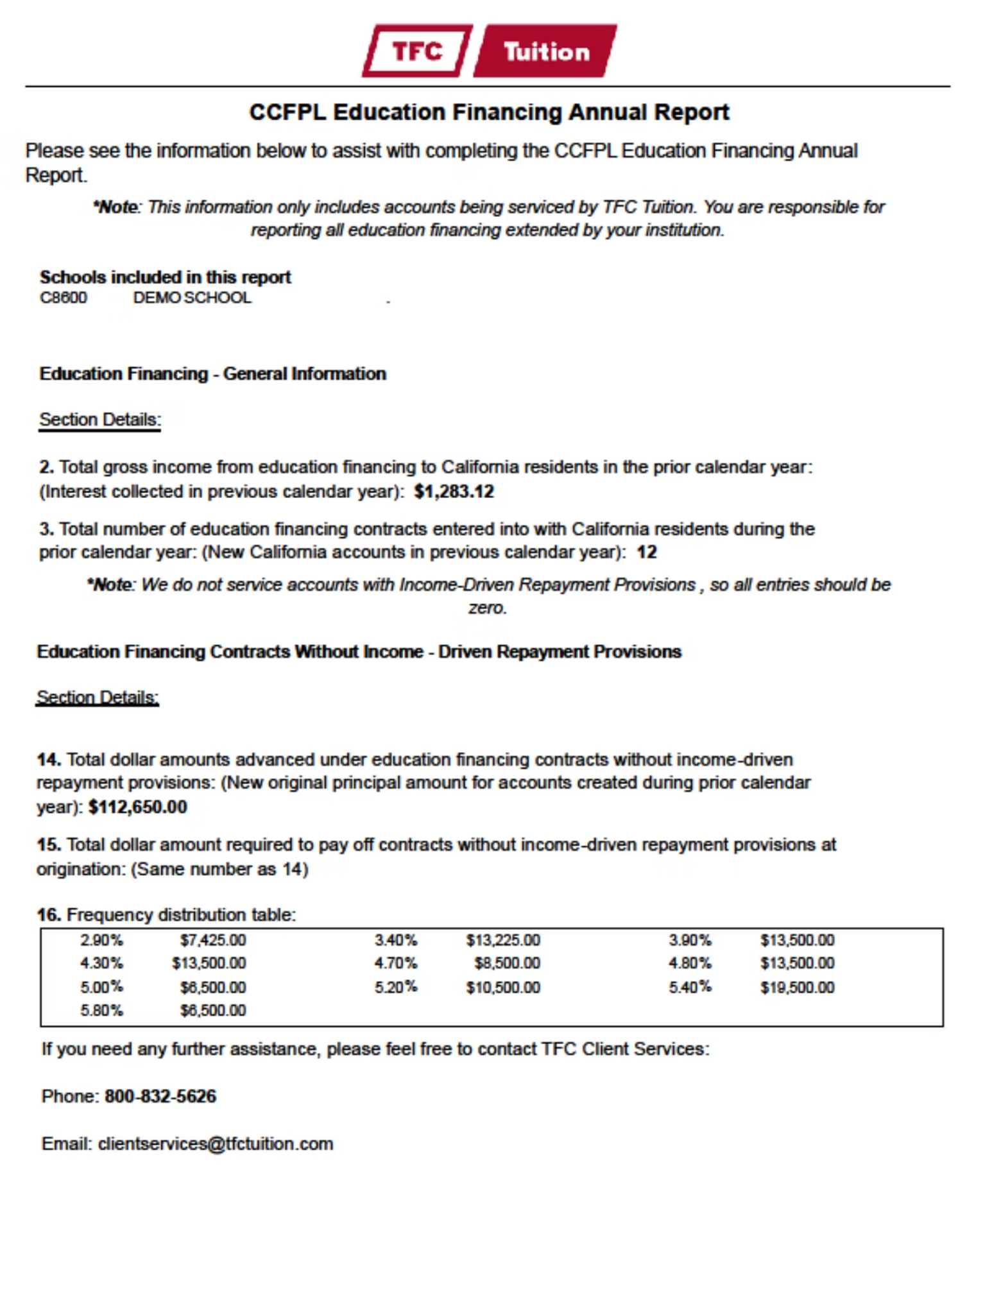

Sample Servicer Report
Your servicer should provide a comprehensive report containing all necessary data points for DFPI compliance. Review this sample format to understand what information you should request from your servicer to complete the annual report efficiently and accurately.
Pro Tip: Reports are already available. Review them early to address any questions prior to the March 16 deadline.

Slide 11



Thank you
Benji Breitbart, TFC Tuition
(800) 832-5626
compliance@TFCtuition.com

